Slide 1
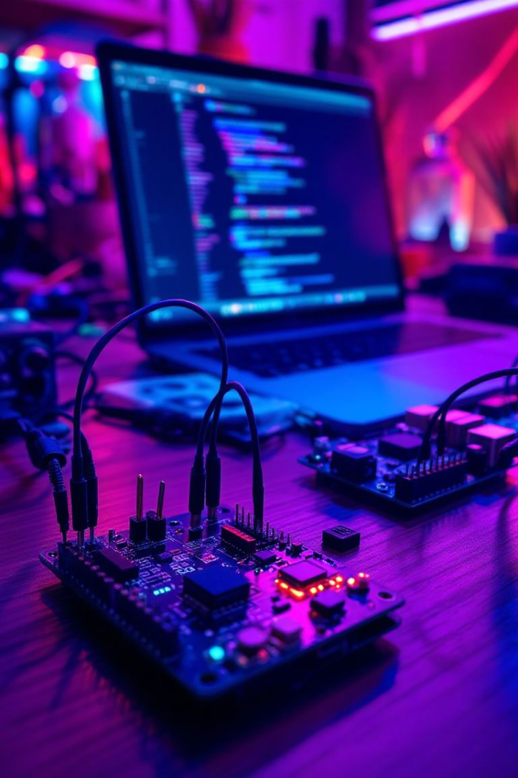
IoT Work Shop
Trick or Treat ?!
Learn and Earn ?!

Slide 2
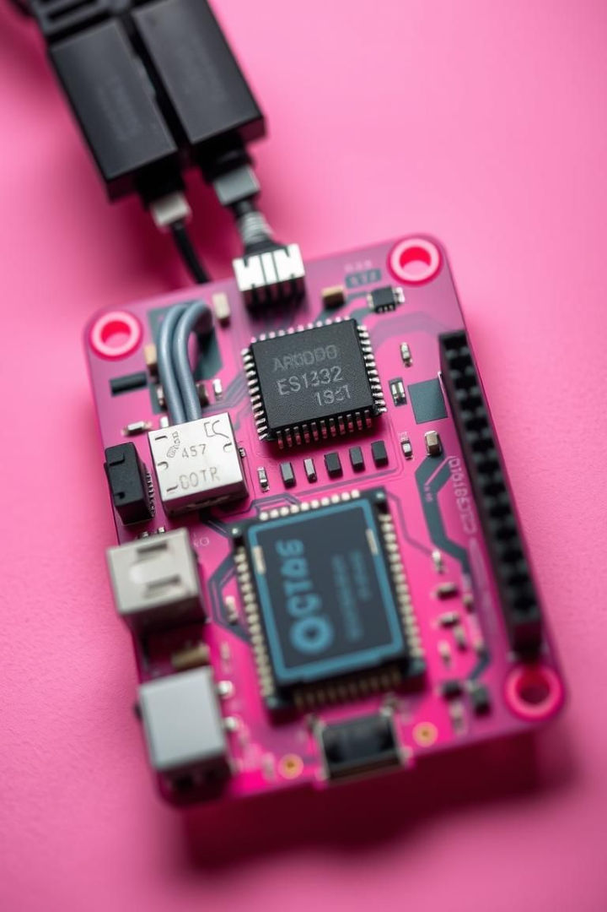
IoT with Arduino & ESP32
A Hands-on Guide to Building IoT Projects
Presenting by Janarthanan on 24/03/2025

Slide 3
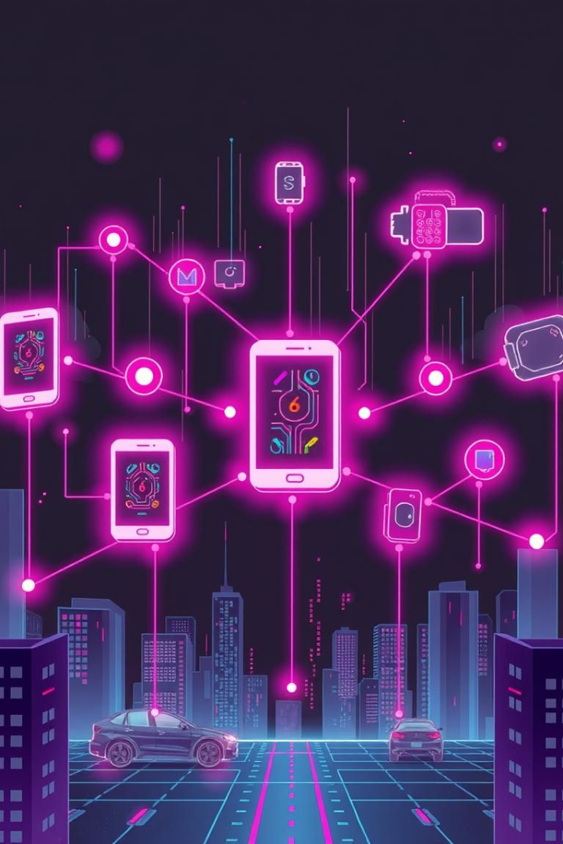
What You'll Learn
IoT Basics & Microcontrollers
Understand IoT principles and the architecture of Arduino & ESP32.
Sensor Integration
Learn to work with temperature, humidity, and light sensors.
Cloud Connectivity
Connect devices to AWS, Azure, and Google Cloud IoT platforms.
Web Interfaces
Build web dashboards for monitoring and control.

Slide 4
IoT Basics & Microcontrollers
What is IoT?
Arduino vs. ESP32
Arduino IDE Setup
The Internet of Things connects devices to the internet. Examples include smart homes and automation.
Arduino is beginner-friendly, while ESP32 is more powerful with Wi-Fi.
Configure the IDE for board selection and library installation.
Link to GitHub Repo - Arduino Basics

Slide 5

Sensor Integration - Light Sensor (LDR)
LDR Introduction
1
Light Dependent Resistors change resistance based on light.
2
Wiring & Connection
Connect the LDR using a voltage divider circuit.
Code Explanation
3
Read analog values to determine light intensity.
Link to GitHub Repo - LDR Sensor Code

Slide 6
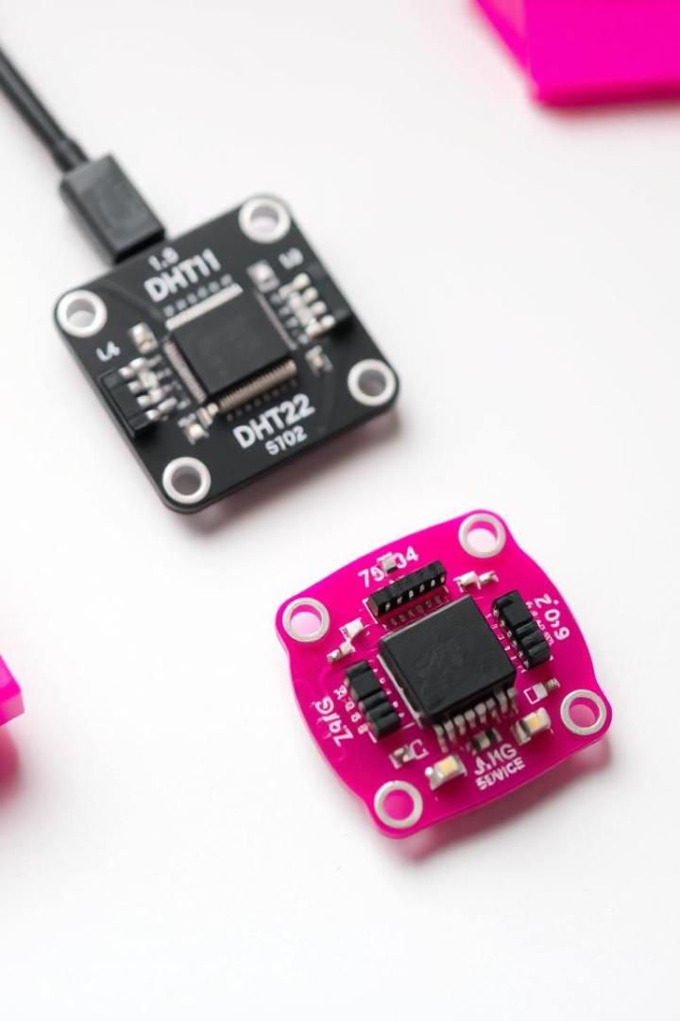
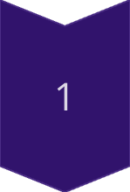
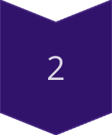
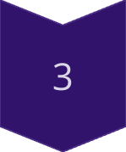
Sensor Integration - Temp & Humidity
DHT11/DHT22 Sensors
Measure temperature and humidity. Consider operating range and accuracy.
Wiring & Connection
Connect the DHT sensor using a schematic diagram.
Code Explanation
Read sensor data using the DHT library.
Link to GitHub Repo - DHT Sensor Code

Slide 7



IoT Impact Across Fields
Healthcare
Remote monitoring improves patient care and lowers costs.
2
Manufacturing
Predictive maintenance boosts efficiency and uptime.
Agriculture
Precision farming optimizes resource use and crop yields.
Automotive
Connected cars enhance safety and convenience.

Slide 8
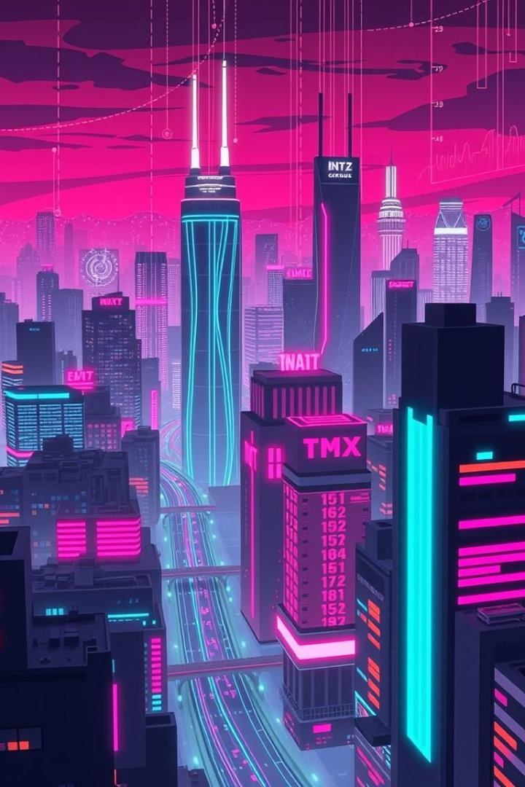

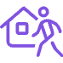

IoT Use Cases
Wearables
Fitness trackers monitor vital signs and activity levels for better health.
Smart Homes
Automated lighting, security, and appliances enhance comfort and efficiency.
Logistics
Real-time tracking and management of goods improves supply chain efficiency.

Slide 9
IoT Applications Across Industries
1
Healthcare 🏥
2
Manufacturing 🏭
Remote patient monitoring and smart medical devices enhance healthcare.
Predictive maintenance and automated production lines improve efficiency.
3
Agriculture 🌾
4
Automotive 🚗
Smart farming optimizes crop yields through precision monitoring and control.
Connected cars and autonomous driving transform transportation and safety.

Slide 10
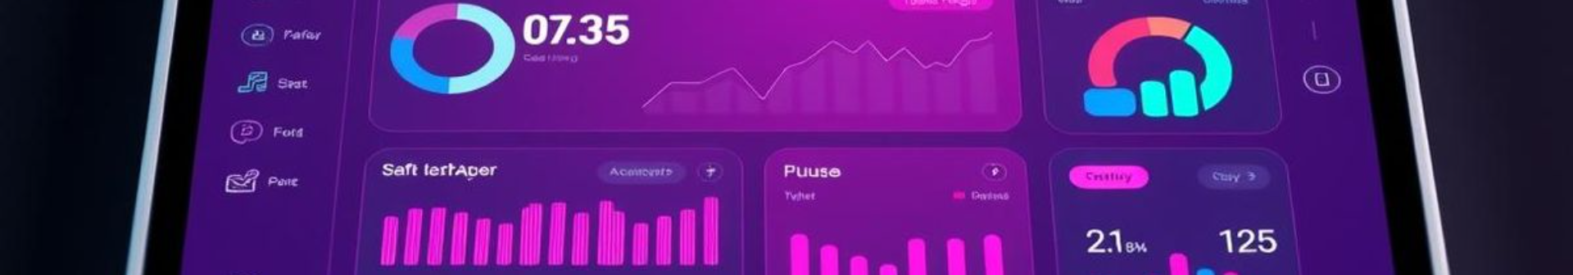
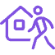


Hands-on Project - Smart Energy Meter System
Project Overview
System Architecture
Code Integration
Link to GitHub Repo - Complete Project

Slide 11
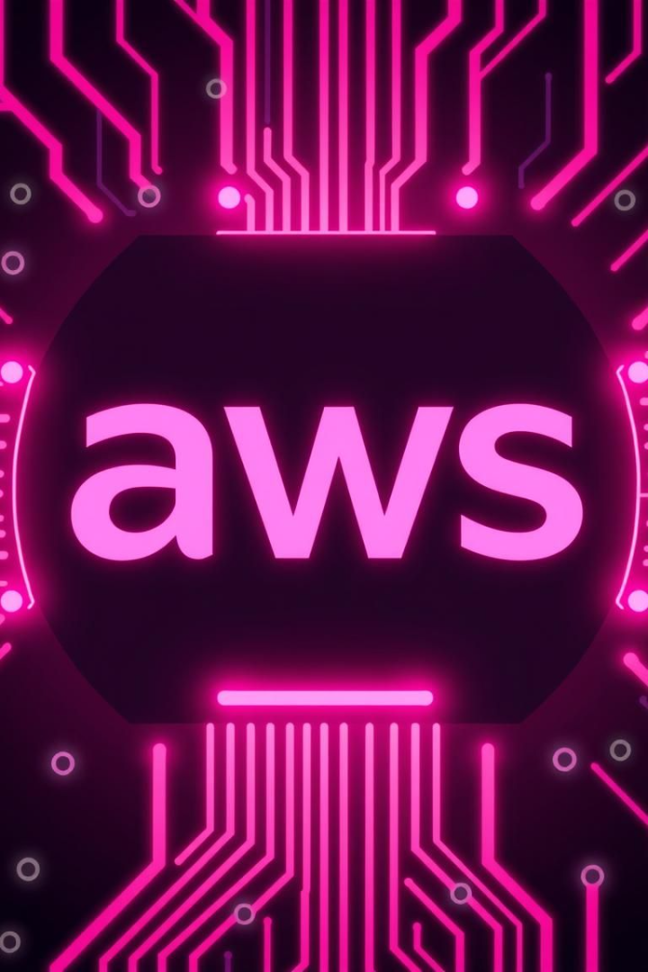
Cloud Connectivity - AWS IoT Core
AWS IoT Core
Setting up AWS
AWS IoT services provide a Device Gateway and Message Broker.
Create an AWS account and configure a "thing."
Code Explanation
Publish data using MQTT.
Link to GitHub Repo - AWS IoT Code

Slide 12



Cloud Connectivity - Azure IoT Hub
2
Setting up Azure IoT Hub
Introduction to Azure IoT Hub
1
Code Explanation
3
Link to GitHub Repo - Azure IoT Code

Slide 13
Web Interfaces - Data with Node-RED
1
Introduction to Node-RED
2
Setting up Node-RED
3
Creating a Dashboard
Link to GitHub Repo - Node-RED Flows

Slide 14

Conclusion & Next Steps
Recap
Recap
Further Learning
We covered IoT basics, sensors, cloud connectivity, and web interfaces.
We covered IoT basics, sensors, cloud connectivity, and web interfaces.
Explore online courses, tutorials, and communities.
Call to Action
Build your own IoT projects!

Slide 15





Workshop Project & Credit
Project Selection
Choose an IoT project. Align with your interests and skills.
Development
Build, test, and refine your chosen IoT project.
Documentation
Document your project goals, code, and hardware setup.
Presentation
Showcase your project. Explain the design and outcomes.
Credit Earned
Receive 2 credits for your IoT project.

Slide 16
IoT Project Selection Ideas
Smart Agriculture 🌾
Healthcare 🏥
Environmental Monitoring 🌍
Develop a system for real-time monitoring of soil conditions. Automate irrigation based on sensor data.
Create wearable device to monitor patient vitals. Send alerts to caregivers.
Build a system to track air quality using sensors. Provide location-based pollution data.

Slide 17

About the Instructor
A Tech Savy and Entrepreneur , Living and ADHD live Peacefully.
Passionate about sharing knowledge and helping others to Learn More.
https://blacklovertech.in
+919994714078

